Slide 1
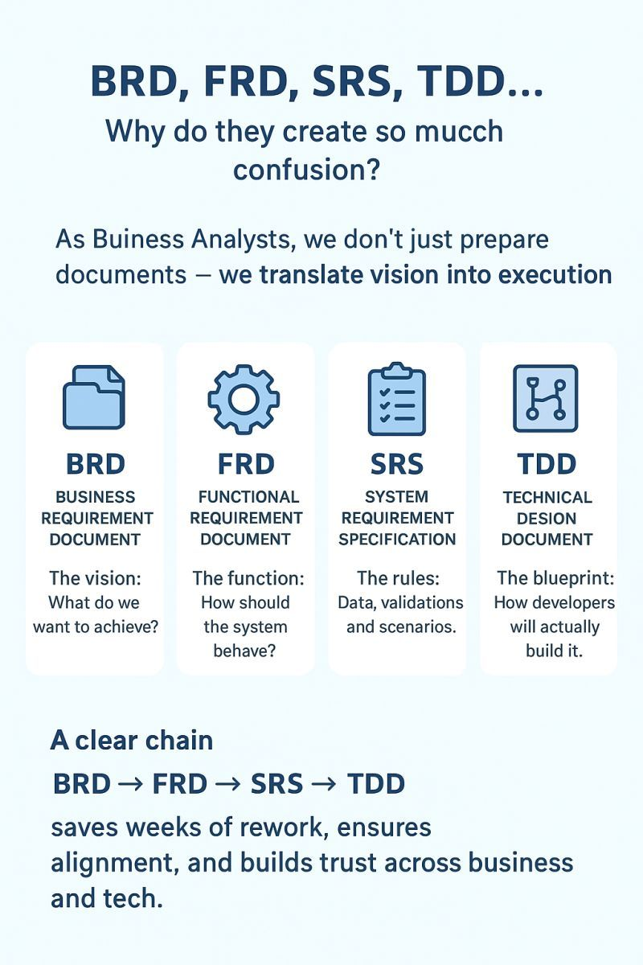
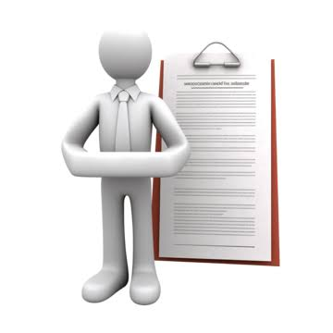
BRD, Epics & User Stories: A Business Analysis Overview
An overview of Business Requirement Documents (BRD), Epics, User Stories, and how business requirements are transformed into actionable development tasks.
Key Topics : 1. Understanding Business Requirement Document (BRD)
2.Understanding Epics and their purpose
3.Understanding User Stories and their structure
4.Relationship between BRD → Epic → User Story → Task
5. Example of converting a business requirement into actionable work

Slide 2
Overview Of Requirements:
Level | Terms | What It Represents | Example
1 | BRD | Overall Business requirement | Need An Online Conference Room Booking System
2 | Epic | Large Feature Or Business goal | Conference Room Management
3 | User Story | Specific requirement from user perspective | As an employee want to book a conference room for conducting meetings
4 | Task | Specific work needed to complete the story | Create booking form and add room availability,confirmation
5 | Sub Task | Smaller step within a task | Design Booking from fields

Slide 3
1.BRD: (Business requirement Document)
Problem Statement
Purpose
Background
Business Objectives
Scope
Functional Requirement
Assumptions & constraints
Stakeholder & Sign Off

Slide 4
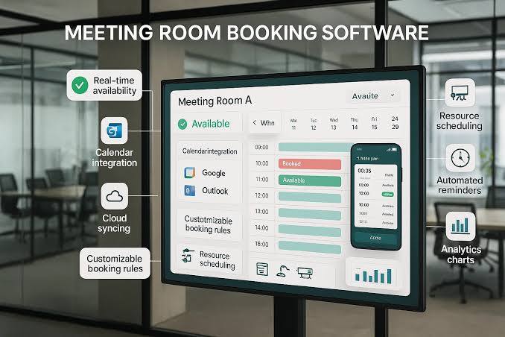
Problem-Statement
Brief: Employees often face difficulties when booking conference rooms because room availability is not always clear. Manual booking through emails, messages, or spreadsheets can result in double bookings, scheduling conflicts, and wasted time. Example: Suppose Employee A wants to conduct a meeting from 10:00 AM to 11:00 AM. They check with a team member and book Room A through email. Later, Employee B also books the same room for the same time because they were not aware of Employee A's booking.
Problem: There is no single, centralized way to view real-time room availability and manage bookings.
Proposed Need: A conference room booking system where employees can check availability, book rooms, modify/cancel bookings, and receive confirmation, while preventing double bookings.

Slide 5
Purpose
Brief: To provide employees with a simple and efficient way to book conference rooms based on availability, date, time, and meeting requirements.
.Point-Wise: Centralize the conference room booking process.
Provide real-time room availability to employees.
Enable users to book, modify, and cancel room reservations easily.
Prevent double bookings and scheduling conflicts.
Save time and improve room utilization.

Slide 6
Background
Brief: Currently, employees may depend on manual communication, emails, or checking room availability separately, which can lead to double bookings, delays, and difficulty finding suitable rooms. .Point-wise: Conference rooms are frequently required for team meetings, client discussions, interviews, and presentations.
Employees may currently use emails, chats, calendars, or manual methods to reserve rooms.
There may be no single centralized view of all room availability.
Employees may spend time checking with others before booking a room.
Multiple employees can unknowingly request the same room for the same time slot.

Slide 7
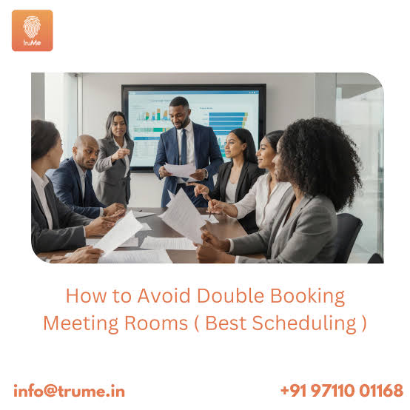

Business-Objectives:
• Reduce double bookings • Improve room utilization • Save employees' time • Provide real-time room availability • Make the booking process simple

Slide 8
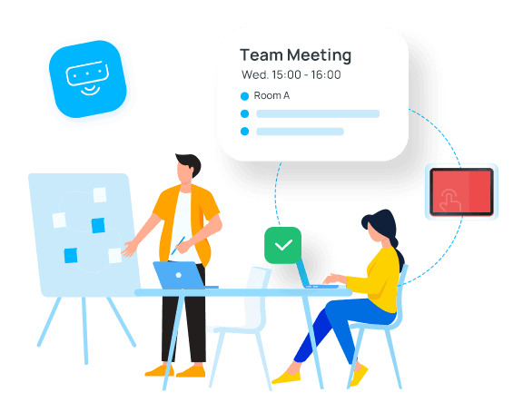

Scope-IN Scope
• View available conference rooms • Check room availability by date/time • Book a room • Cancel or modify a booking • Receive booking confirmation • View existing bookings

Slide 9
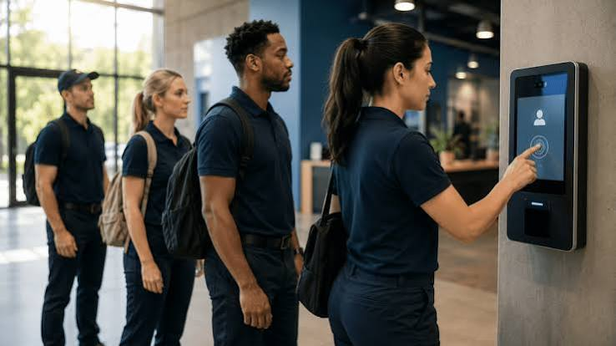

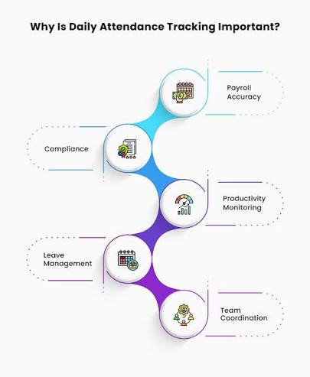
Scope-scope out
• Managing office infrastructure • Physical room maintenance • Employee attendance tracking • Managing external venue bookings

Slide 10
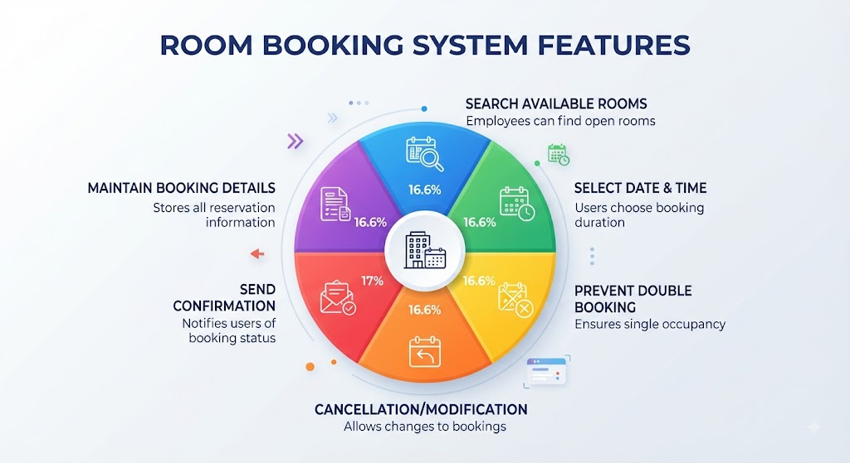
Functional-Requirements
Brief:
• System should allow employees to search for available rooms. • System should allow users to select date and time. • System should prevent double booking. • System should allow booking cancellation/modification. • System should send booking confirmation. • System should maintain booking details.

Slide 11
Assumptions & Constraints
Brief: (Assumption) Employees have valid company accounts; room information is already available in the system.
Brief: (Constraints)
Only authorized employees can book rooms; a room cannot have multiple bookings for the same time slot.
Assumptions | Explanation | Constraints | Explanation
Employees have valid company accounts | Users are expected to have authorized accounts to access the booking system | Only authorized employees can book | External users or unauthorized employees cannot make bookings.
Room information is available | Details such as room name, capacity, location | Limited number of conference rooms | The system can only manage rooms that are registered in the organization.

Slide 12
Stakeholders & Sign-off
Brief: (Stakeholders): Employees, Team Leads/Managers, Admin/Facilities Team, IT Team, Business Analyst, Project Manager. Brief: (Signoff): Business Owner / Project Manager / relevant stakeholders approve the BRD before development begins.

Slide 13
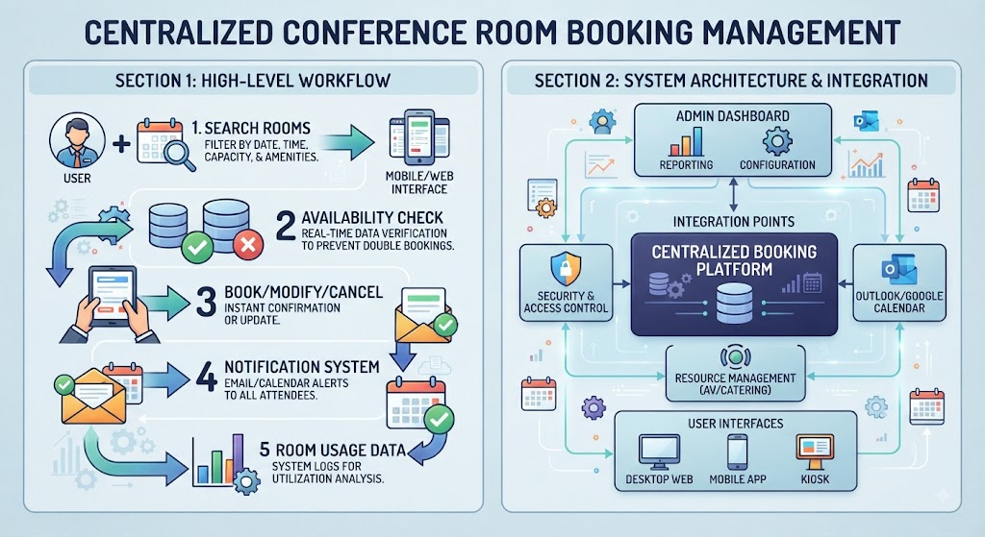
From BRD to Epic, User Stories & Tasks
1. Epic: Epic: Centralized Conference Room Booking Management DESC: Enable employees to efficiently find, book, modify, and cancel conference rooms through a centralized system while preventing double bookings and scheduling conflicts. USER

Slide 14
Break the Epic into User Stories
User Story | Description
US-01: View Room Availability | As an employee, I want to view available conference rooms based on date and time so that I can select a suitable room for my meeting.
US-02: Book a Conference Room | As an employee, I want to book an available conference room by providing meeting details so that I can reserve the room for my meeting.
US-03: Manage My Booking | As an employee, I want to modify or cancel my existing booking so that I can manage changes to my meeting schedule.
View Room Availability USER-1
Book a conference room User-2
Manage My Booking User-3

Slide 15
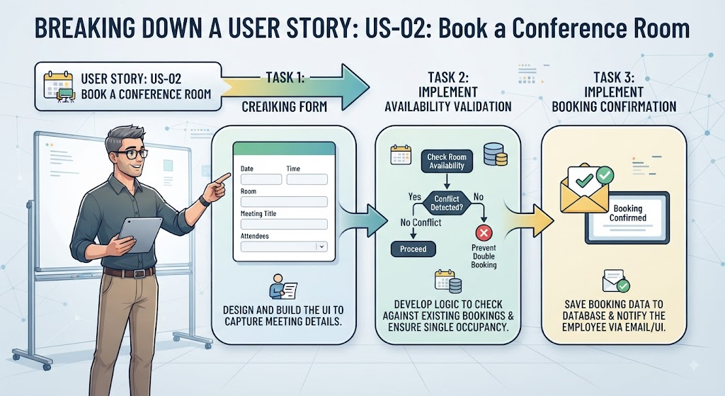
Break One User Story into 3 Tasks
Task | Description
Task 1: Create Booking Form | Create a form to capture date, time, room, meeting title, and other required details.
Task 2: Implement Availability Validation | Check whether the selected room is available for the requested date and time and prevent double booking
Task 3: Implement Booking Confirmation | Save the booking and display/send a confirmation to the employee.

Slide 16
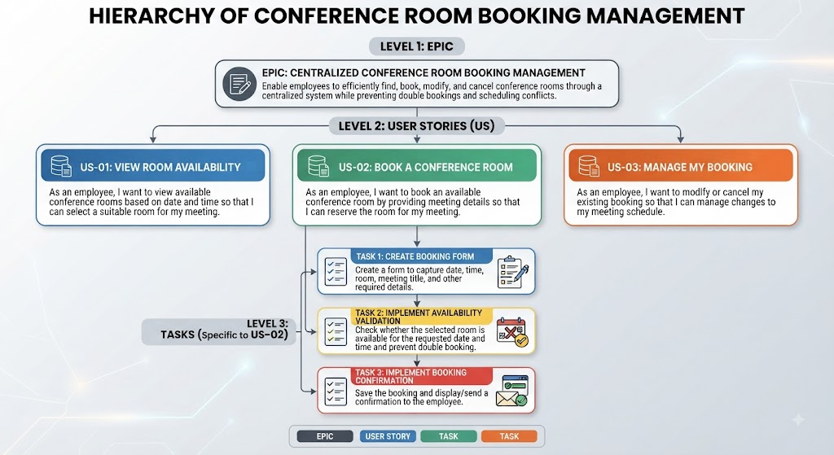
Overall hierarchy

Slide 17
THANK YOU!!

